Slide 1



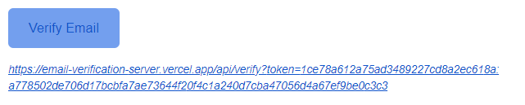
EMAIL VERIFICATION
Nadav Goldin, Matan Nachmuna

Slide 2
Introduction
The registration page allows new users to create an account.
Account verification ensures that users are registered with a valid email address.
Ensures that the email belong to the user.

Slide 3
npm install nodemailer
Nodemailer History
Creation: Nodemailer was created by Andris Reinman in 2010.
Purpose: It was developed to address the lack of good email sending options in the Node.js ecosystem.
Growth: Over the years, Nodemailer has become the de facto standard for sending emails in Node.js applications.
Community: It has a large user base and strong community support, leading to continuous development and improvement.

Slide 4
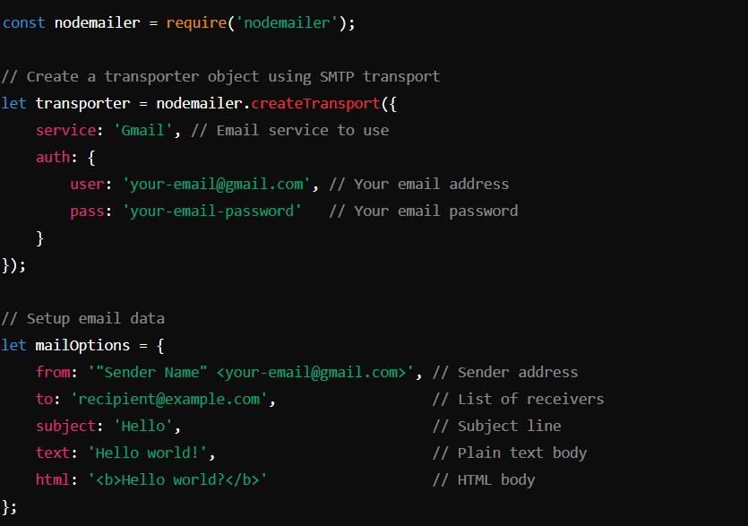
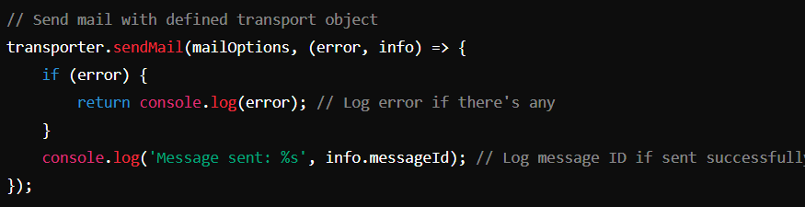

Slide 5
Registration Process
A user fills out the registration form – POST request to server.
The server sending an email to verify the account.
The user clicks on the verification link in the email.
The account is verified and can be logged in.

Slide 6
Verification link
https://email-verification-server.vercel.app/api/verify?token=44a29d840a8578880f0de912cd40b117:244c2c1f214d02500c3e178997841fb0c81bc35dedd7ef8bbfb4a732bf28a7ef
IV
Encrypted email
Client
Server
Fill the form
Send POST signup request to the server
Sign-up
Send email to the client with the verification link
Press on the verification link
Verifying the user and display message

Slide 8

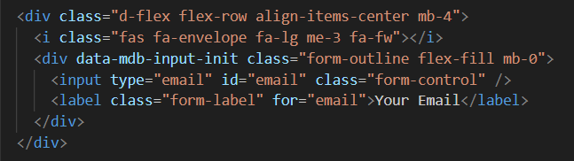
Sign Up page

Slide 9
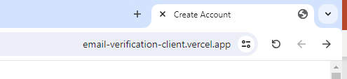
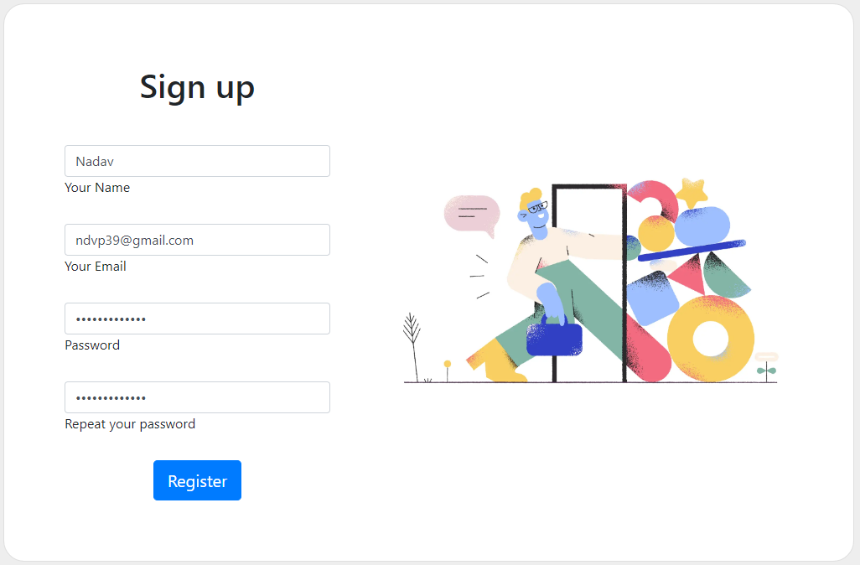
Sign Up page – client on vercel

Slide 10
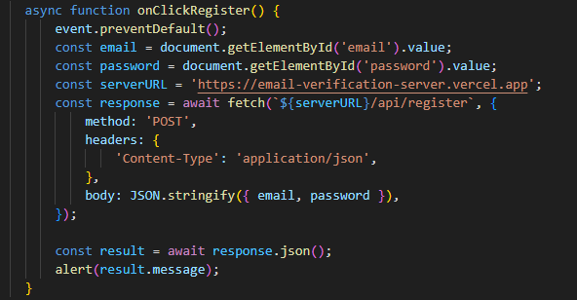
JavaScript

Slide 11
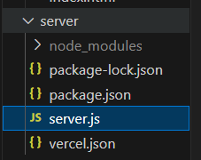
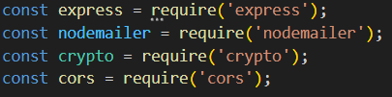

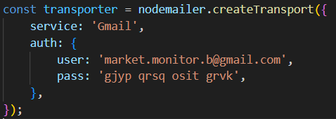
Backend

Slide 12


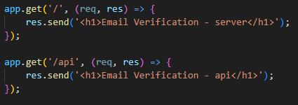
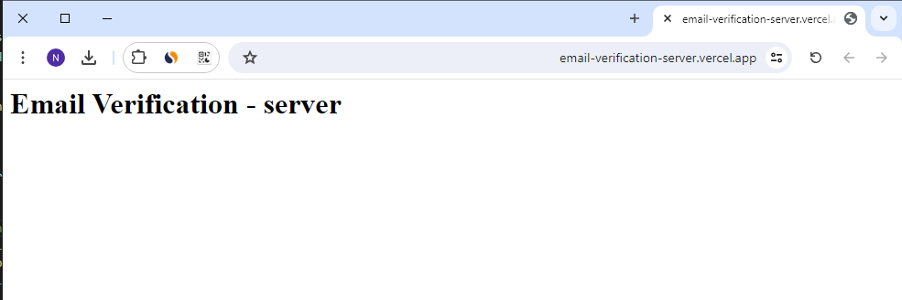
Server on vercel

Slide 13
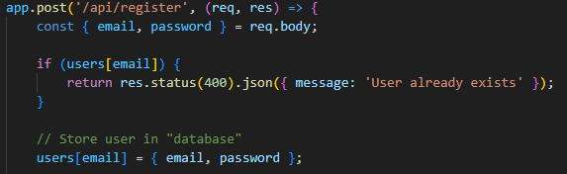
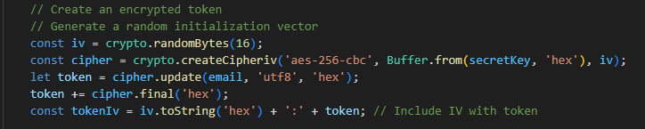
Backend – register POST request
Creating token

Slide 14
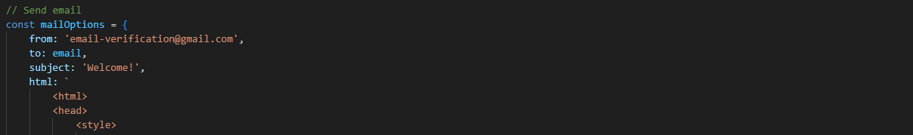
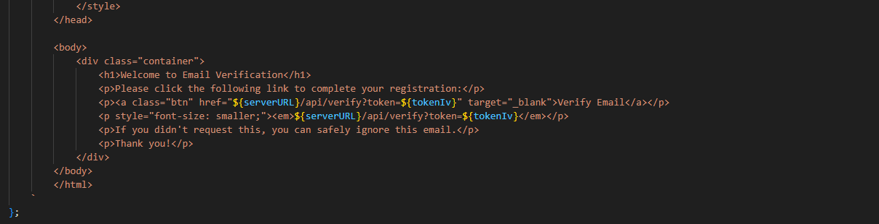
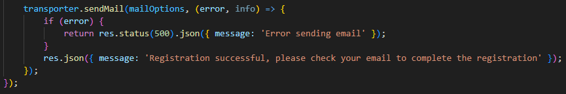
Backend – register POST request

Slide 15
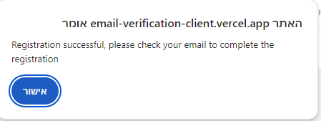
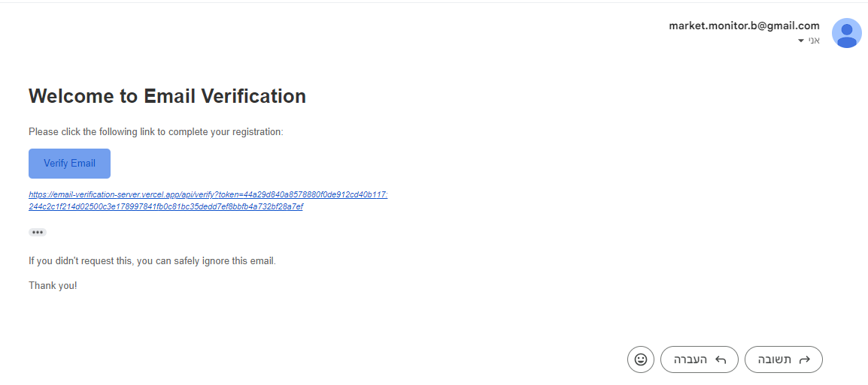
Verification
After the user click on Register
Email sent to the user

Slide 16
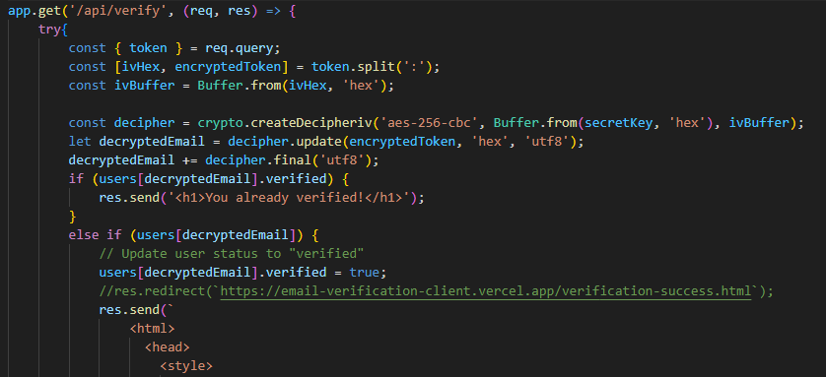
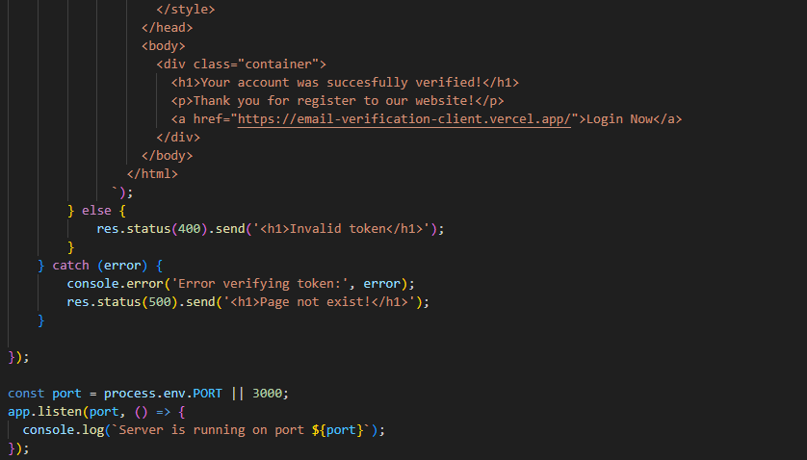
Server verifying
Verification link
https://email-verification-server.vercel.app/api/verify?token=44a29d840a8578880f0de912cd40b117:244c2c1f214d02500c3e178997841fb0c81bc35dedd7ef8bbfb4a732bf28a7ef
IV
Encrypted email

Slide 17
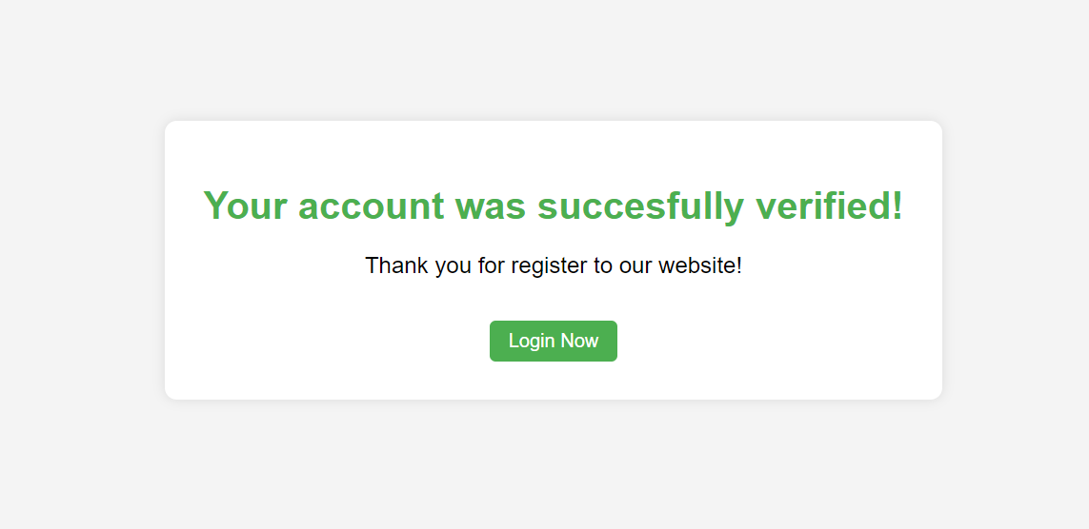
Server verifying

Slide 18
How to create password for sending emails?

Slide 19
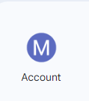
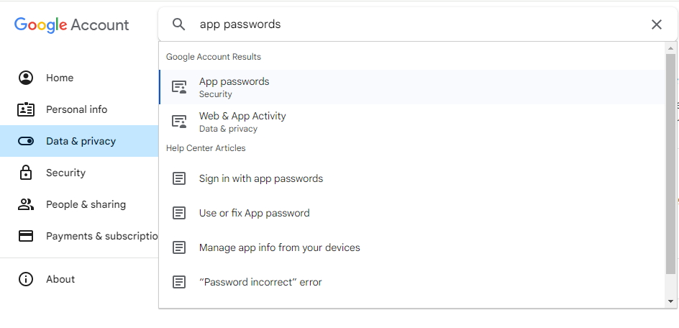
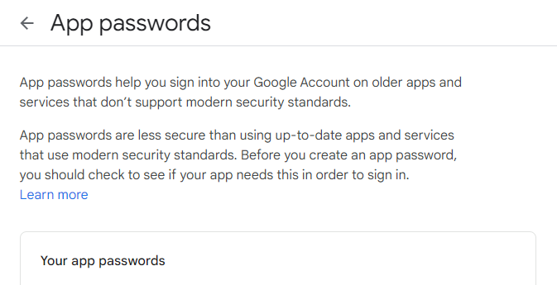
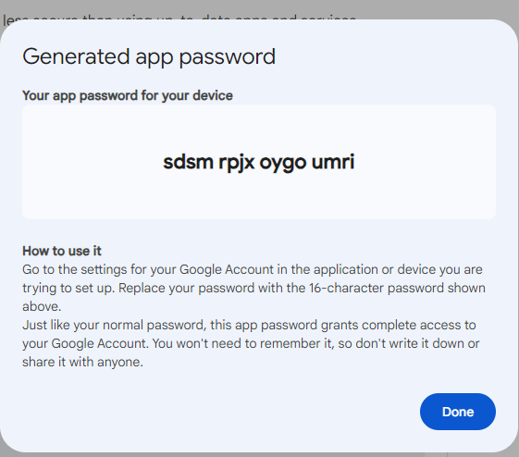
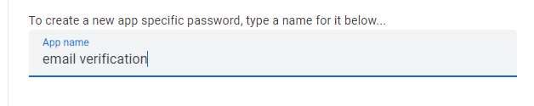

1
https://myaccount.google.com/
2
3
4

Slide 20
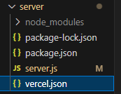
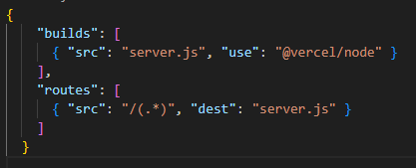
vercel.json

Slide 21
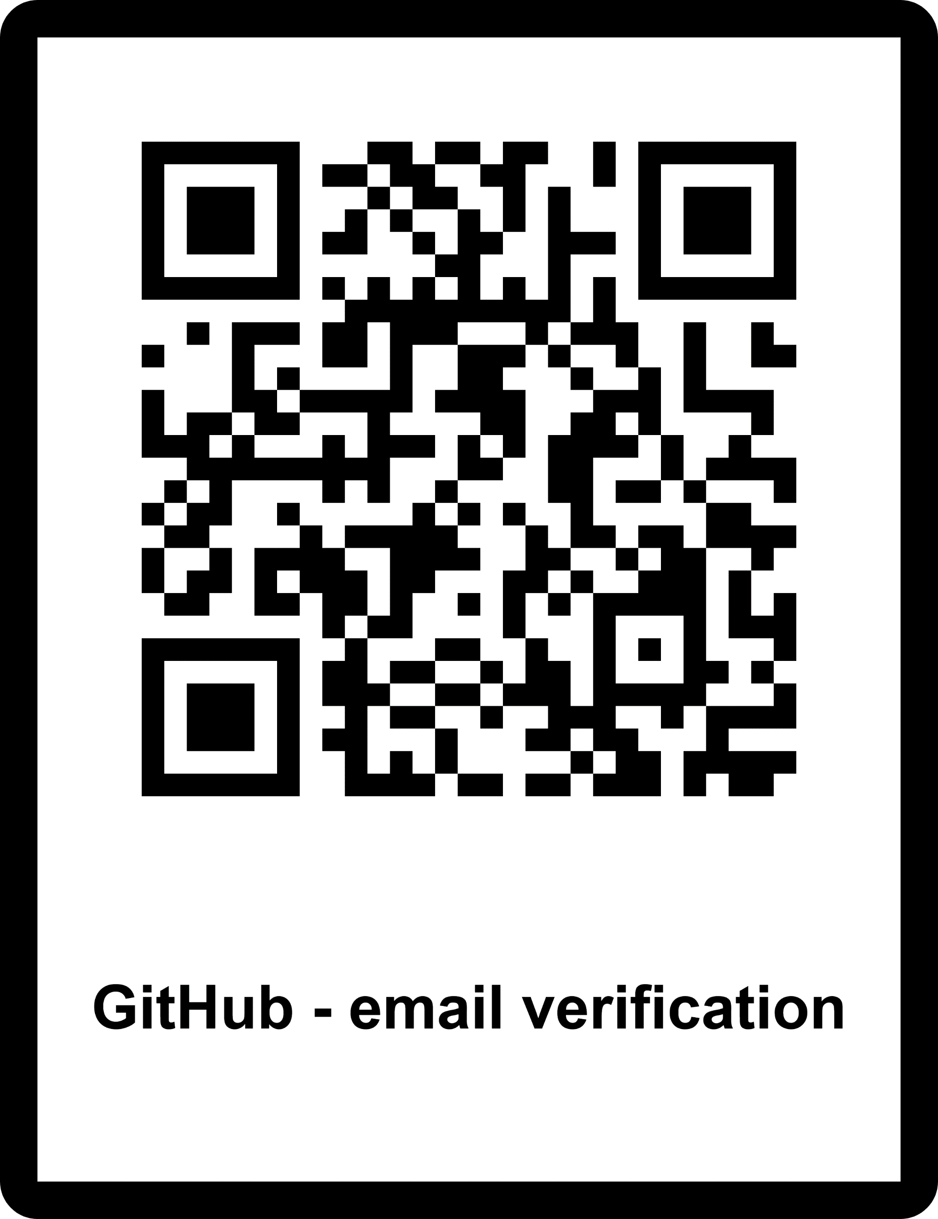
EMAIL VERIFICATION
Questions?
Nadav Goldin, Matan Nachmuna

